Slide 1

Virtual Placements
Richard Ward
Principal Lecturer
University of Cumbria
Antony Freeman
Principal Lecturer
University of Cumbria
Notes:
-Intro by Ant and Rich – CEPP – IoH – Project leads for the 'Live Virtual Placement Trial' at UoC
-A 'Live virtual placement' is exactly that, learners access real placement settings via a remote/virtual platform...We will explore the detail here later on.
-Aim:
-We hope to walk attendees through the project to date, starting by exploring the key challenges within our sector and how we think this project is neatly positioned to mitigate the risk from these challenges.
-We will conclude by discussing our next steps and what we think the future holds for this area of work.

Slide 2


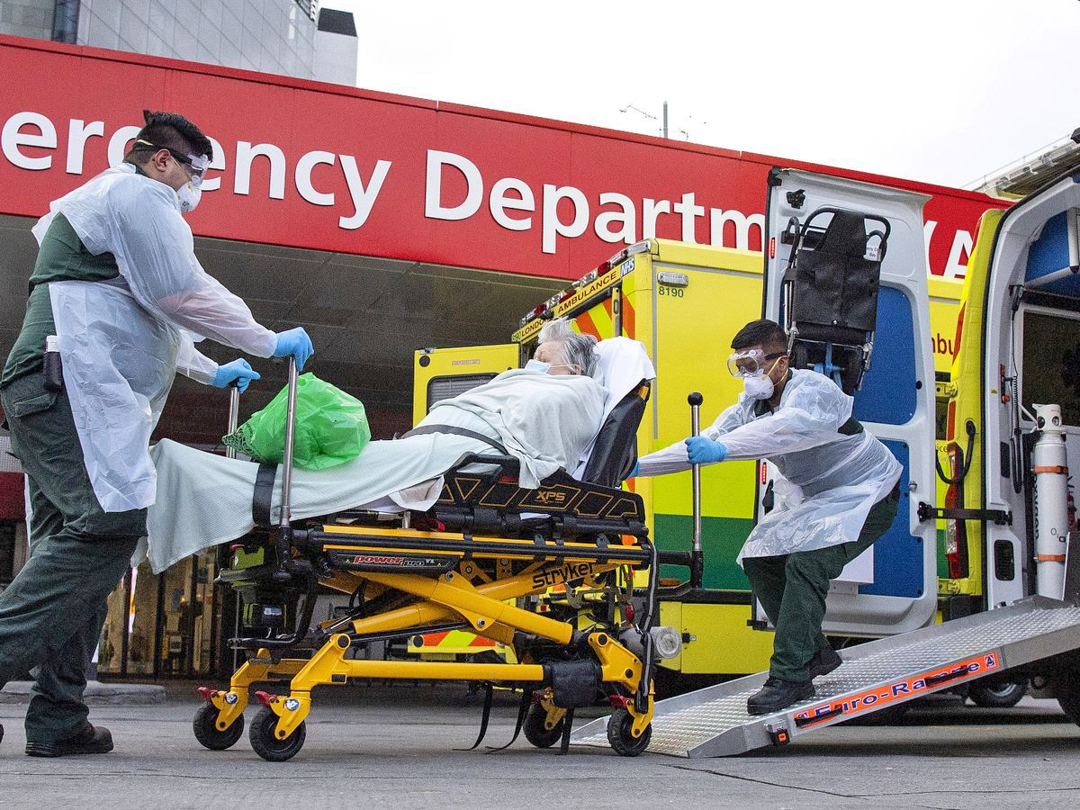
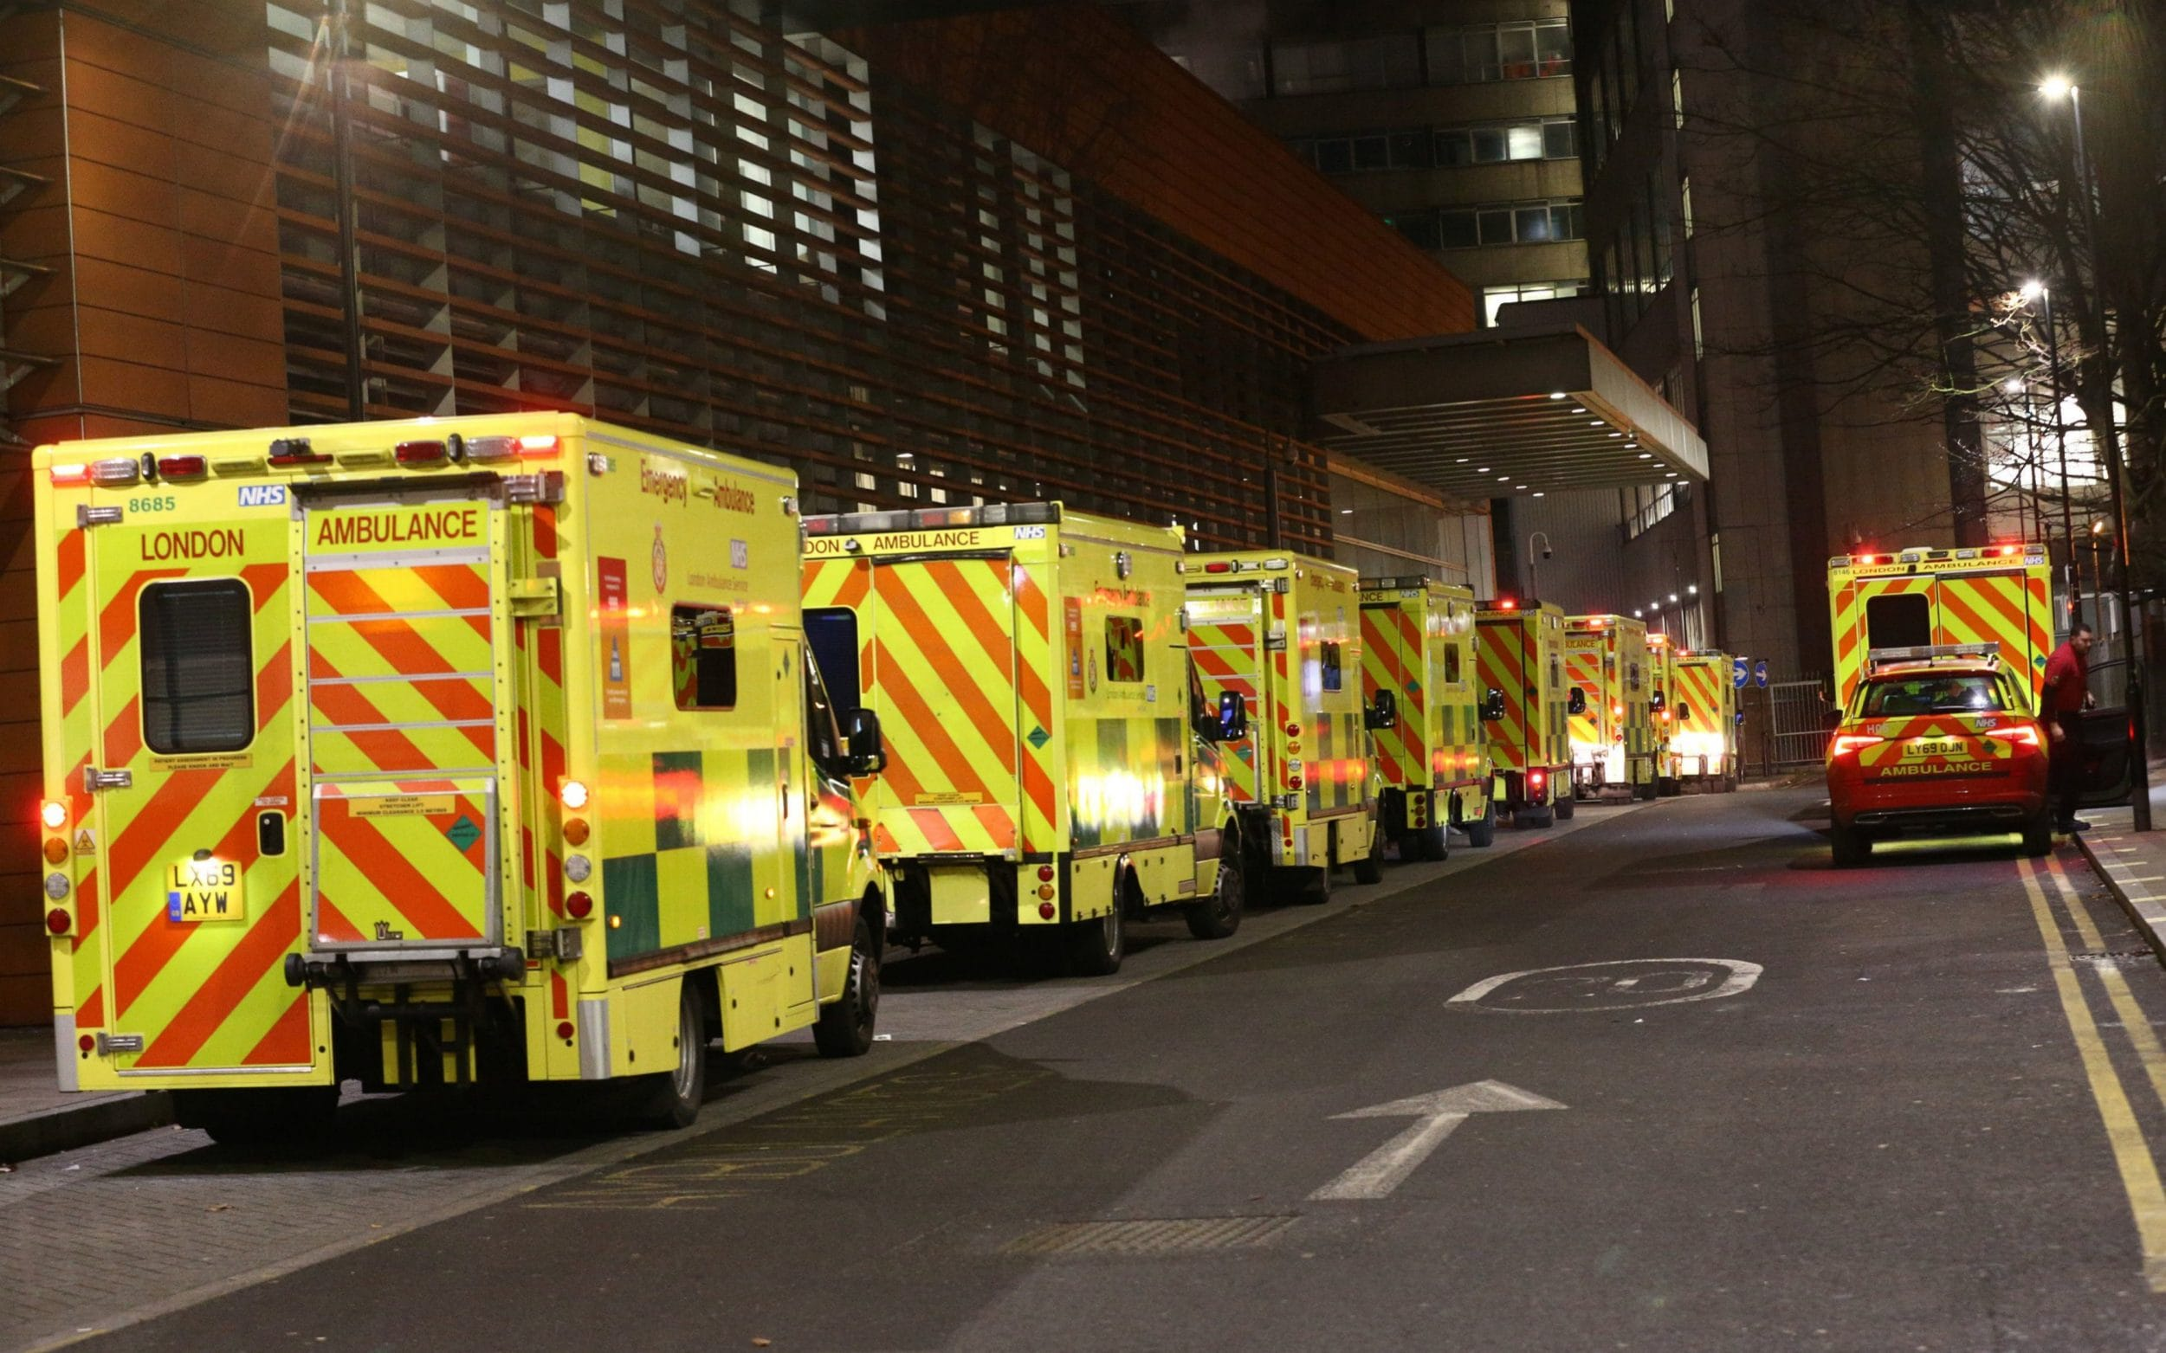



Notes:
The Why...
Walk through sector challenges that evidence the rationale for a change in practice and the introduction of live virtual placements
Staffing issues due to varying reasons – Need to recruit more staff = More learners. Leads to increase learners needing placement which leads to capacity issues.
But more learners also means more supervisors = supervisor capacity is stretched...seeing placement hours in ambulance settings reduced in areas
Placement capacity is a significant risk to health programmes in the higher education sector and this has a significant impact upon learner experiences and the development of their knowledge, skills, and behaviours. This may negatively impact care provided to patients in the future if not mitigated against, where graduates enter the workforce with a more limited experience.
Apprentice feedback - responding to practice survey that identified lack of placement diversity. Various reasons have lead to this feedback, but hours spent queuing at hospital is a leading contributor, alongside ongoing challenges to expand physical placement locations available to our learners.
NHS long term plan- bringing evidence to diverse the role of the paramedic ...diversifying placement experience to match this need is required
During the pandemic we also saw a loss of placement hours due to the risks of having learners physically in placement settings

Slide 3




The Solution - Live Virtual Placements
Notes:
The How...
Describe what we mean by a live virtual placement
Remote and digital option for learners to access healthcare placement opportunities, to supplement current physical placement opportunities and not to replace these
Funded by an internal Health Education England grant that is to be used to create a virtual placement experience that will expand and diversify the placement experience offered to apprentice paramedics within the Institute of Health
Led by a project steering group has been setup to oversee the delivery of and quality assure the virtual placement experience being offered as a pilot, by the University of Cumbria
Pilot = three virtual placements SEM2e streamed directly to the UoC via MS Teams.
Each virtual placement algins to module learning outcomes and indicative content from two module: holistic wellbeing and primary care
Lessons plans consist of half day of live streaming to a class room on campus, with seminars in the afternoon to build upon the mornings experience
Opportunity to have Q&A sessions with practitioner after the live streaming event
Recordings made and streamed from Digimed. Stored securely on the UoC server and can be re-used for future sessions with differing learner groups. Reviewed for clinical accuracy as time goes on.
Virtual placements we feel will give learners opportunities to experience environments, clinicians, and patients they may never have encountered previously as a learner, which supports their wider understanding of the health sector. It may also ignite a passion for future career opportunities, and support workforce needs by targeting virtual placements in areas where there are recruitment and/or retention issues.
Gives rise to IPL opportunities too.
Links to new Paramedic SoP requirements around being a digital professional, interacting in the digital space

Slide 4

Evidence Base
Notes:
The evidence base is limited...This will come as no surprise, but we could not find any paramedic research in this area.
-There is a growing evidence base for simulated virtual placements
-Summarise the below articles
https://insight.cumbria.ac.uk/id/eprint/6380/
https://insight.cumbria.ac.uk/id/eprint/6148/
https://onlinelibrary.wiley.com/doi/pdfdirect/10.1111/medu.14772
https://journals-sagepub-com.cumbria.idm.oclc.org/doi/full/10.1177/23779608221117392
https://insight.cumbria.ac.uk/id/eprint/6832/

Slide 5

Project Roadmap
Notes:
-The What...
-Walk through our project timeline...Big picture
Example of our Lay out our project roadmap
Mid January, Propose and agree on transmission dates Mid-January 2023
2 Mid January DigiMed team selection/composition - Mid-January 2023
3a First week of February- Bi-weekly team briefings established and running By first week in February 2023
3b Mid March0 Agree contracts and costs By mid-March
4 Mid March- identify GP practice ready for broadcast By mid-March 23
5a End of March- Agree with chosen GP/GPs the framework and scope of each live programme including learning outcomes
By
5b End of March - Agree process to manage data and consenting process/documents
By end March 23
6a First week of April- Run a full infrastructure test from GP surgery to the transmission location including bi-directional audio check, camera placement and test upload
First week in April 23
7a First Week of April Develop a lesson plan for the day including afternoon seminars, create learner communications evaluation form and after care guide
First week in April 23
7b 19th of April- Set up day for session 19th April 23
8 20th of April- 1st go live day
9 End of April- Debrief after first session and take all learnings forward to the next event, formal evaluation
End April 23
2x more live placements:
17b Formally evaluate the full experience for impact
End of July 23
18 Communicate impact to wider UoC colleagues and HEE and discuss next steps for the future
End of July 23
-Discuss measurables
Key Objectives:
Compliance- Understand key legislation and polices
IT platforms – identify appropriate IT platforms and perform audit. Ensure they meet the objectives of the placement
Constructive alignment – ensure placement meets LOs and indictive content of the target modules
Equality, diversity and inclusion - allow equal opportunities to access placements, make teaching rooms inclusive
Quality assurance and improvement – understand and evaluate learner experiences, measure impact upon learner attaintment, implement quality improvements
Finance – Oversee ongoing costs, ensure the project stays within parameiters

Slide 6

Next Steps
Looking forward..
Evaluate the impact of these experiences and use this data for quality improvement measures
Conduct primary research to grow the evidence base in this area
Understand limitations of live experiences and build from there
Seek opportunities for collaborations
Notes:
The future...
-Evaluation
-Primary research
-Expand upon the pre-recorded/bespoke virtual opportunities
-Seek opportunities for collaboration

Slide 7

Any Questions?
Notes:
-In CEPP we are always keen to establish relationships with others in the sector, we feel we are stronger together and would love the opportunity to move forward collaboratively in this space.
-Any questions?

