Slide 1
Integrating centre-based and school-based learning through a reflective journal for postgraduate student teachers
Dr Mike Toyn, Dr Deborah Seward, Jacqui Percival
University of Cumbria

Slide 2
Literature background
‘Theory’ and ‘practice’ (Hobson, 2003) (Stenberg, Rajala & Hilppo, 2016)
Gap (Hobson, 2003, Lunenberg & Korthagen, 2009, McGarr, O’Grady & Guilfoyle, 2017, Korthagen, 2018)
Something to be bridged (Ramsaroop & Gravett, 2015, Stenberg, Rajala & Hilppo, 2016)
a nexus (la Velle, 2019), an interplay (Boyd, 2022) or as transference (Philpott, 2006).
Notes:
Given that we are looking to strengthen the way that centre based and school based training interlink. The natural area of literature to explore is around ‘theory’ and ‘practice’.
In much of the research, these two terms are used by students to mean ‘centre based’ and ‘placements’. Within the literature reviewed so far, there is an interesting use of vocabulary used to describe this ranging from gap to something to be bridge, a nexus, an interplay and a transference of learning from one context to another

Slide 3
Why?
“HEI-based component is justified by a belief that this impacts in some beneficial way on workplace practice” (Philpott, 2006, p284)
Notes:
Philpott goes on to explain why this is an area which has been revisited over time and continues to be of prime interest (particularly with accreditation and intensive school based elements) is the underlying belief that what is done in centre based training is beneficial to workplace practice.
This does omit the reverse link, that what is learned in school can support centre based training, forming a positive feedback loop.
However, it does make a case for actions in place to bring the two together.

Slide 4
Research questions
How do different stakeholders conceptualise a reflective scrapbook and what value does it have in supporting the integration of theory and practice on a post graduate teacher preparation programme?
How do students conceptualise the scrapbook and how do they use it to integrate theory and practice?
How do tutors conceptualise the scrapbook and how do they use it within their teaching?
How do mentors conceptualise the scrapbook and how do they use it to support student learning during placements?
Notes:
Having introduced this scrapbook, we are keen to research its impact. We would obviously be evaluating its use but we wanted to go beyond this and establish a research project to explore in detail.
Particular interest in the way that it is conceptualised by stakeholders: students, tutors and mentors.
In other words, how similar are everyone’s views. We are at the start of the project now and have opted for an action research approach as we hope to be able to use this to refine the way it is used over time in order to bring a convergence of conceptualisations over time. Leading to a shared understanding that maximises impact.

Slide 5
Context
Integrating school-based learning and centre-based learning
PGCE primary programme
School Direct and campus based
Notes:
Context of trying to support deeper integration between school based learning and centre based learning on a primary PGCE
Programme covers both SD and campus based (core) PGCE. SD is taught in alliance largely by alliance colleagues within guidelines offered by University. So typically see variation in delivery patterns within agreed boundaries.
Introduced a reflective scrapbook as a tool to help with this integration. Had been piloted in a SD alliance in 2019 and then more widely adopted as part of a new validation that began in Sept 2021

Slide 6
So far …
Introduced in 2021/22
Data drawn from tutor interviews
Guidance for students revised for 2022/23
Data drawn from students and school based colleagues

Slide 7
Programme developments
2021 – 2022 | 2022 – 2023
Reflective Scrapbook | Reflection – just doing it
Directed activities linked to subject and pedagogy centre-based training | Prompts for reflection linked to staged expectations
Weekly activities set | Expectation of engagement on weekly basis
Notes:
Change in name to de-emphasise the name ‘scrapbook’ as some students were overly focussed on presentation
Reduced the directed expectations in order to avoid students perceiving that it was a series of tasks to be completed (and thus that tutors would assess, rather than being something of intrinsic value to them)

Slide 8
Five Themes
The role of reflection in programmes
Differing depths of reflection (Korthagen 2011)
Types of approaches adopted by students (Tang et al, 2019; McGarr, O’Grady and Guilfoyle, 2017)
The development of a reflective practitioner identity (Boyd 2022)
The transfer of learning between settings (Lunenberg & Korthagen, 2009).

Slide 9

Student derived data

Slide 10
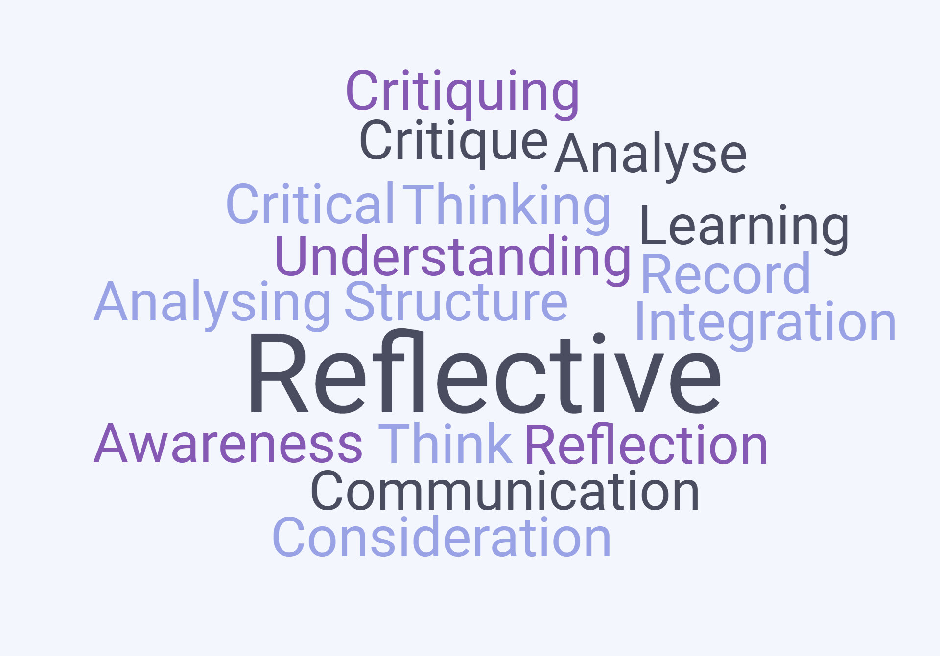
Mentor derived data
Notes:
Much wider range of words from mentor responses. Possibly indicating that too much is being expected of it.

Slide 11
Theme 1: Role of reflection in programmes
Students can articulate the value of reflection. They appreciate ‘prompts’ to help close the loop. They are aware of the expectation to be reflective in the Teachers’ Standards
Dialogue stimulus between trainee and mentor.
Notes:
Top statements in dark blue are drawn from the analysis of student questionnaire responses in relation to each of the themes. Lower statements in dark blue are drawn from mentor / link tutor responses
Consensus around the value of it being a stimulus or acting as a prompt.
Interesting that students link to TS as a gateway to QTS, which acts as a nice bridge to the second theme

Slide 12
Theme 2: Depths of reflection
Tended towards proceduralist approach (Stenberg et al., 2016 ) e.g. taking notes, focusing on what doesn’t work and ways to fix it etc
Helps students to become more critical and reflective
Notes:
Students more functional / transactional – they want QTS and see this as something that needs to be ticked off to help them get there. Very surface level reflections.
Mentors see it as having value in encouraging a reflective and critical mindset

Slide 13
Theme 3: Types of approaches
Often adopting a functional approach (Korthagen, 2011) prompted by things that did / did not work rather than based on pupils’ learning
Working document but one that students need to take ownership of so it “fits with their own learning”
Notes:
Again, there is a link to the previous theme for students as they adopt a functional approach – what do I need to do to make my teaching better
But not making a link between their reflections and pupil learning
Nor do mentors make this link.
They want students to see an intrinsic value in the process and to adapt it to suit the student’s learning needs.

Slide 14
Theme 4: Developing an identity as a reflective practitioner and inhibiting factors
Seemingly, two viewpoints. Those who see it as integral to being an educator (minority). Those who used it less as the programme progressed, thus not developing a reflective practitioner identity (majority)
Encourages thinking. Can be difficult to engage all students.
Notes:
There is a match here between the two viewpoints. Mentors see the value but acknowledge it can be difficult to engage all students.
Probably explained by the fact that there are two viewpoints. Those who are easy to engage see it integral to becoming an education

Slide 15
Theme 5: Transfer of learning between settings and theory practice links
Typically used more in centre-based sessions (Tang et al, 2019)
Built into every training session through scaffolds and prompts. Evidences the transformative nature of learning linked to theory.
Notes:
Students are more likely to use it in centre-based sessions. Implying that any potential transfer is one directional only.
Comments from mentors were limited in relation to this. Probably as a result of their limited understanding of our ITE curriculum. This comment was provided by a tutor who taught in university and is also a link tutor.

Slide 16
Current state of play
Alignment in the role of reflection in programmes
Semi alignment around approaches – needs to coalesce around pupils’ learning and the transfer of learning – needs a stronger place in school-based learning
Mis-alignment in the conceptualisations of this reflective tool in relation to depths of reflection and developing an identity as a reflective practitioner
Limited degree of mentor engagement

Slide 17
Outcomes of ITAP
Students should have a ‘strong grasp of the evidence base concerned, which they can articulate, justify and exemplify, and the ability to identify effective classroom delivery and to prepare and apply those aspects of teaching confidently in a range of contexts.’

Slide 18
Implications for ITAP / next steps
Need for effective interplay of learning between the two contexts of centre-based and school-based learning
Need to assess ITAP will raise the status of the scrapbook with students
Need to encourage students to reflect in relation to pupil learning
Need to encourage greater use during school-based learning

Slide 19
References
Boyd, P. (2022) ‘Learning Teaching’ in school. Chapter In Cooper, H., & Elton-Chalcraft, S. (2022). Professional studies in primary education
Hobson, A. J. (2003) Student teachers' conceptions and evaluations of ‘theory’ in initial teacher training (ITT), Mentoring & Tutoring, 11:3, 245-261
Korthagen, F (2011) Making teacher education relevant for practice: the pedagogy of realistic teacher education. Orbis Scholae, 2011, Vol. 5, No. 2, pp. 31-50
Lunenberg, M. & Korthagen, F. (2009) Experience, theory, and practical wisdom in teaching and teacher education, Teachers and Teaching: theory and practice, 15:2, 225-240
McGarr, O., O’Grady, E. and Guilfoyle, L. (2017) Exploring the theory-practice gap in initial teacher education: moving beyond questions of relevance to issues of power and authority. Journal of Education for Teaching. 43:1, pp.48-60 accessed 14/3/22
Philpott, C. (2006) Transfer of learning between higher education institution and school‐based components of PGCE courses of initial teacher education, Journal of Vocational Education and Training, 58:3, 283-302
Ramsaroop, S., & Gravett, S. (2015). Bridging theory and practice in teacher education: teaching schools - a bridge too far? Perspectives in Education. 33, 131-146
Stenberg, K. Rajala, A. and Hilppo, J. (2016) fostering theory-practice reflection in teaching practisums Asia Pacific journal of teacher education. Vol. 44, No. 5, pp. 470-485
Tang, S. Y. F., Wong, A. K. Y., Li, D.D. Y., & Cheng, M. M. H. (2019) Examining student teachers’ engagement with the theory-practice link in initial teacher education. Journal of education for teaching. 45:2, pp. 123-139
Tang, S. Y. F., Wong, A. K. Y., Li, D.D. Y., & Cheng, M. M. H. (2019) Examining student teachers’ engagement with the theory-practice link in initial teacher education. Journal of education for teaching. 45:2, pp. 123-139

Slide 20
Student derived data
Role of reflection in programmes | Students can articulate the value of reflection. They appreciate ‘prompts’ to help close the loop. They are aware of the expectation to be reflective in the Teachers’ Standards
Depths of reflection | Tended towards proceduralist approach (Stenberg et al., 2016 ) e.g. taking notes, focusing on what doesn’t work and ways to fix it etc
Types of approaches | Often adopting a functional approach (Korthagen, 2011) prompted by things that did / did not work rather than based on pupils’ learning
Developing an identity as a reflective practitioner and inhibiting factors | Seemingly, two viewpoints. Those who see it as integral to being an educator (minority). Those who used it less as the programme progressed, thus not developing a reflective practitioner identity (majority)
Transfer of learning between settings and theory practice links | Typically used more in centre-based sessions (Tang et al, 2019)

Slide 21
Mentor derived data
Role of reflection in programmes | Dialogue stimulus between trainee and mentor. Helps students to become more critical and reflective
Depths of reflection | Thinking emerged as a key word.
Types of approaches | Working document but one that students need to take ownership of so it “fits with their own learning”
Developing an identity as a reflective practitioner and inhibiting factors | Encourages thinking. Can be difficult to engage all students.
Transfer of learning between settings and theory practice links | Built into every training session through scaffolds and prompts. Evidences the transformative nature of learning linked to theory.

