Slide 1

Moving towards more authentic assessment design: making assessment work better for students.
A keynote for the University of Cumbria’s Learning & Teaching conference
Sally Brown
and Kay Sambell
Lancaster campus, June 12th 2024
Notes:
Moving towards more authentic assessment design: making assessment work better for students.
Sally Brown and Kay Sambell for the University of Cumbria, June 2024 (90 mins. see LTA Plan)
Assessment and feedback have a significant and powerful impact on the lives of both students and staff. In this keynote, Professors Sally Brown and Kay Sambell will discuss the importance of universities recognising that assessment practices and processes can have a substantial positive or negative impact on students, depending on how they are directed, and that staff engaging in designing and conducting assessments need appropriate approaches that lead to effective learning, aligning with the Assessment for Learning movement to which both have contributed.
Building on the extensive resources Kay and Sally have created to support staff during pandemic times, (see https://sally-brown.net/kay-sambell-and-sally-browncovid-19-assessment-collection/), the keynote will review how authenticity in assessment can enhance students’ capabilities, preparing them for employability, active citizenship and a stronger sense of personhood, whilst also being manageable for staff. In this session participants will have opportunities to:
Review how authentic assignments can be systematically and efficiently designed to foster student engagement, belonging and commitment;
Consider how changes can be made incrementally to improve the quality of learning opportunities afforded by assessment activities;
Examine a practical six-stage approach to designing authentic and constructively aligned assessment activities;
Reflect on how these kinds of approaches can be implemented at Cumbria in alignment with your strategic plans for assessment..

Slide 2
Why might we want to introduce more authenticity into our assessment practices?
This aligns fully with the new UoC Learning and Teaching Plan:
Students often find it inherently interesting and rewarding;
Used well, it can be a driver for effective learning ;
It can be a powerful means of developing students’ higher order thinking skills;
Authenticity in assessment tends to be invaluable in motivating students who recognise its validity and long-term relevance;
It can foster among students a wide range of life-relevant skills and attributes;
There can be genuine rather than tokenistic opportunities for inclusive practice;
Authentic approaches can help promote academic integrity;
Tasks can link well to real-world challenges (if associated with industry, professions or civic groups)

Slide 3

Assessment for (and as) Learning: rethinking assessment to strike a better balance
THEORETICAL CONTEXT
Learning
function
Measurement function

Slide 4
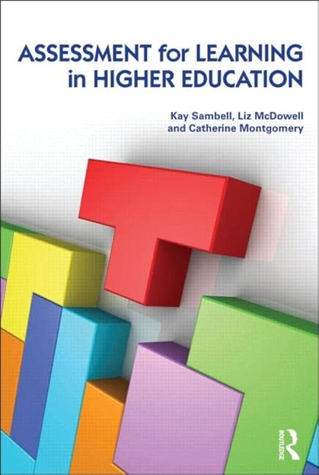
6 AfL conditions – design principles for creating HE learning environments which foster scholarly curiosity and involvement with disciplinary knowledge
Emphasise authentic and complex tasks
Use high stakes assessment rigorously but sparingly
Offer extensive low stakes confidence building opportunities and practice
Are rich in formal feedback
Are rich in informal feedback
Explicitly develop students’ abilities to evaluate their own progress and direct their own learning
Notes:
Our seminal work involved redesigning asst to shift culture of overall l environments

Slide 5
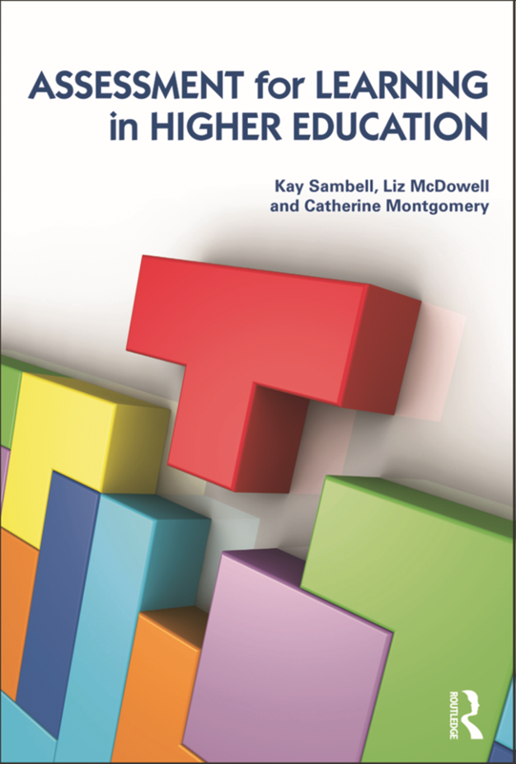
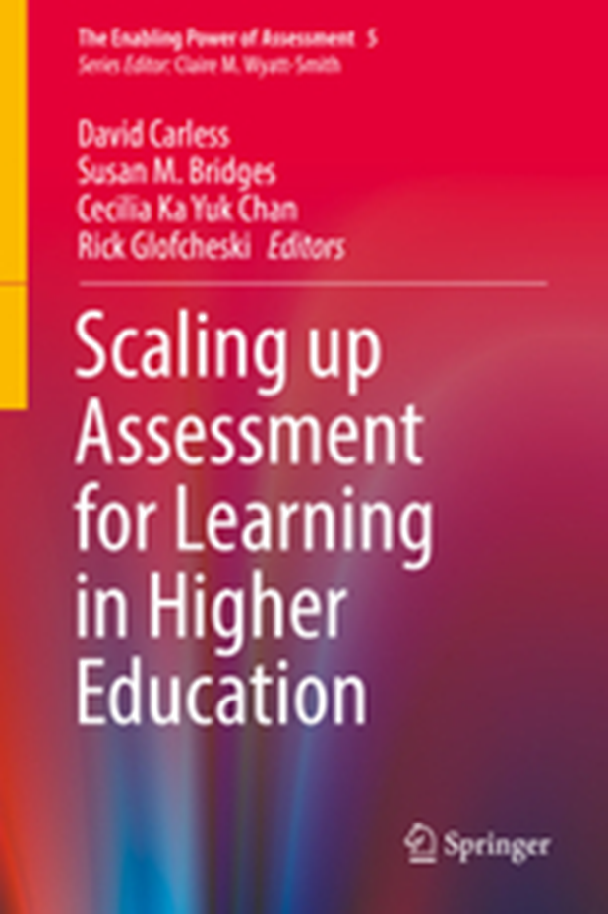
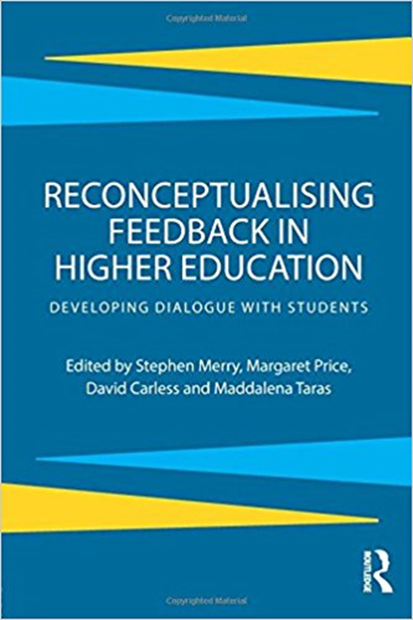
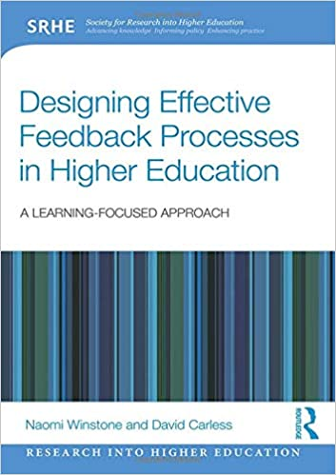
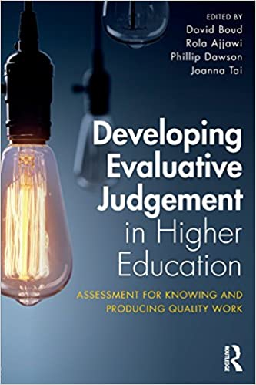
Energise & engage by designing more authentic, learning-oriented assessment tasks
Enable student engagement with guidance and feedback processes
Empower learners to develop evaluative expertise and self-regulation
Notes:
Module teams, or better, subject areas/course teams can think about how they design programmes which motivate, develop and support sts by…

Slide 6
Task: can you reflect on what kinds of assessment you are currently using that aren’t really working well to foster learning?

Slide 7

Our examples of assessments we don’t think work so well.
Unseen time constrained exams which rely heavily on recall and memorization rather than interpretation and analysis;
Lab book assignments which use a repetitive, formulaic template where the interesting bit of analysis of results only comes in at the very end of the report;
Formulaic essays which have bland titles and just require students to follow a pattern, without a great deal of reflection or agency.

Slide 8

Our view is that AfL happens when assessment tasks seem more authentic or relevant than many traditional methods can allow because they:
Have potential to keep your assignments more current and relatable;
Promote student ownership, interest and engagement;
Can enhance students' employability, citizenship potential and self-reliance by building advanced skills
Are more valuable, relevant and future-focused than many conventional assignments.
RELEVANT

Slide 9

Universities started thinking about changing assessment due to Covid: let’s not go back to an over-reliance on traditional exams in the era of Generative AI! Exams have many drawbacks (French et al, 2023).
The exam format is unlikely to authentically reflect a genuine workplace situation
Traditional exams lack relevance to students’ future lives in employment, entrepreneurship and civil society, since they are not in any meaningful way a valid representation of what work or life challenges typically require.
The range of activities that students are asked to do in a traditional written exam are very limited, writing with a pen individually in silence, with no reference to wider resources.
In employment and wider contexts, however, most will have internet access and keyboards
Valued skills (eg listening, teamwork and communication) and the ability to apply feedback are restricted in high-stakes exams and an experimental, iterative approach to learning is discouraged
Inclusivity, equity, anxiety and wellbeing issues a
Notes:
French-Problematic in terms of validity (and backwash on LT), Stress, anxiety and wellbeing
Inclusivity and equity issues
Bretag et al (2019) large scale surveys suggest ‘examinations provide universities…with a false sense of security’ and an ‘over reliance on exams without a through and comprehensive approach to integrity, is likely to lead to more cheating, not less’ Bretag, T., Harper, R., Burton, M., Ellis, C., Newton, P., van Haeringen, K., Saddiqui, S., & Rozenberg, P. (2019b). Contract cheating and assessment design: Exploring the relationship. Assessment & Evaluation in Higher Education, 44(5), 676–691. https:// doi. org/ 10. 1080/ 02602 938. 2018. 15278 92

Slide 10

What do students learn from doing exams?
Designing Assessment for learning means that students learn through the act of doing assessment, and we typically want HE to emphasise critical thinking, reflective practice and creativity. But many exams are out of kilter with this, so time-constrained, invigilated in-person exams often inadvertently place emphasis on practices like rote learning, memorisation and recall.
Instead we might:
  Reduce how much of the overall assessment diet exams form
  When we do choose to use them- we need to think about how we are going to repurpose them to make them more worthwhile.
  An important step is to think very clearly about encouraging students to apply knowledge.
  We can try things like open book exams, in-tray exams, or 2 stage exams. (e.g. see Sambell & Brown, n.d, HWU)
Notes:
Motivation = extrinsic/performative

Slide 11
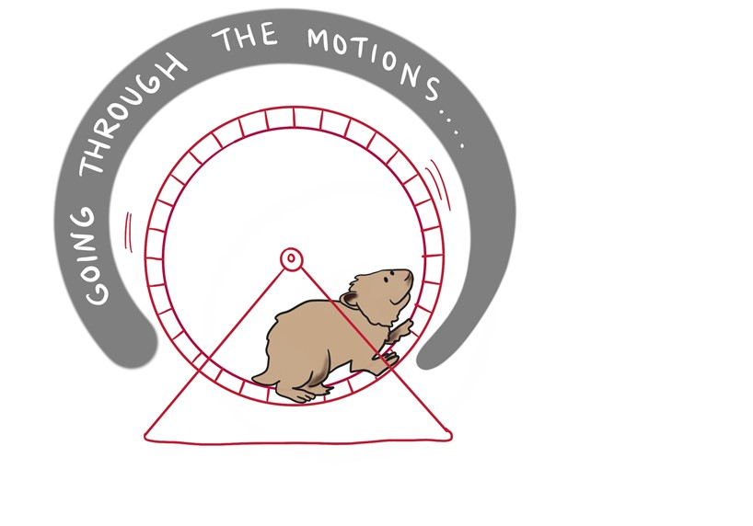
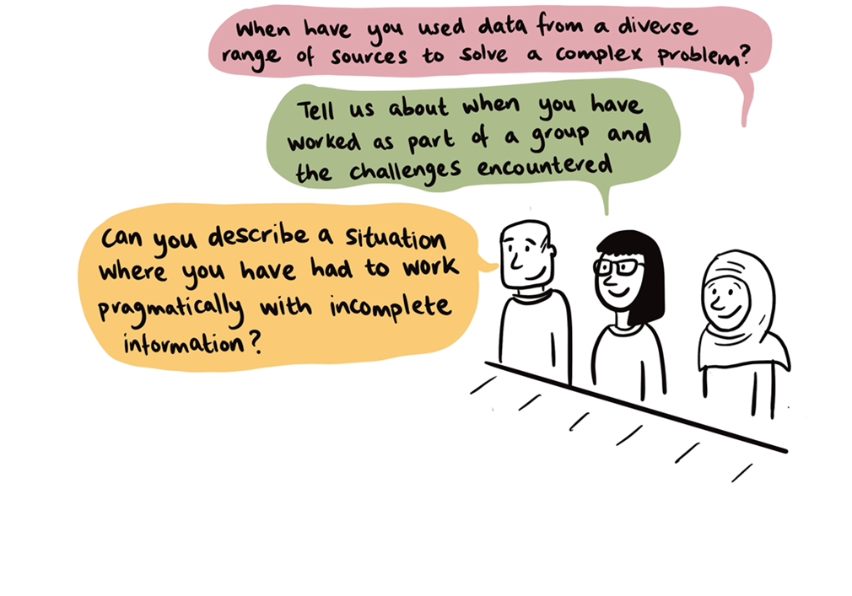

Our seminal research into the impact of assessment
Found that using types of assessment that are more like the ‘real things’ that academics or professionals do in the field, and/or which they can see as having relevance in future, generally engage students more meaningfully than tasks which rely on triggering a set response or give a sense of going through the motions (Sambell, McDowell and Brown, 1997; Sambell et al, 2013)
Notes:
Consequential validity

Slide 12
There are lots of alternative assessment methods- might some be more learning-oriented?
An electronic or hardcopy portfolio
A viva voce or interactive oral assessment
Blogs
Articles or other types of publication
Videos/audios/podcasts
Rough guides, leaflets and other public documents/outputs
Annotated bibliographies
Creative artefacts
Presentations or performances
See Sambell and Brown 2020 June 20 Changing Landscapes of Assessment; Sambell & Brown 2023 Choosing-and-using-fit-for-purpose-assessment-methods Heriot Watt University

Slide 13
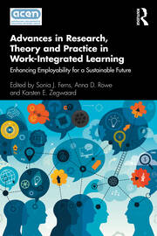
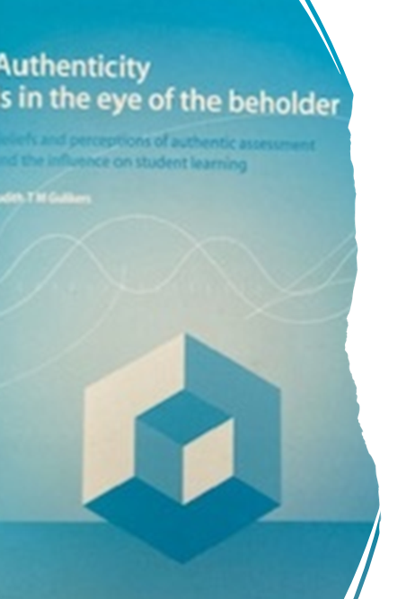
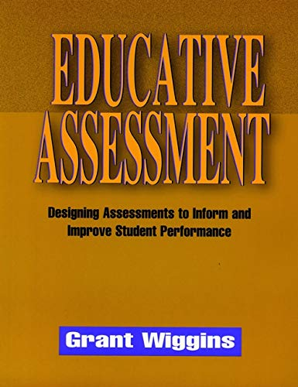
Extensive literature on authentic assessment in higher education…..contested term
Notes:
There is an extensive and longstanding body of scholarly work on the value and impact of authentic assessment on learners (see for example, Wiggins 1990, Gulikers et al 2004, McDowell and Sambell 1998, Davison 2007, Ajjawi et al 2019 ch in WIL book, Hobbins et al 2022) but it’s a contested term….varying definitions (positioned along a continuum)

Slide 14
COMPLEX MULTI-DIMENSIONAL CONSTRUCT e.g.
8 critical elements that determine authentic assessment
(Ashford-Rowe, Herrington & Brown 2014)
Challenge
Product/outcome
Transfer
Metacognition
Recognisable to stakeholders
Fidelity
Discussion and feedback
Collaboration
Notes:
Several influential reviews of the extant literature on authentic assessment have synthesized complex, multi-dimensional models of authentic assessment, highlighting a range of inter-related underpinning characteristics or core dimensions (e.g. Ashford Rowe, 2014; influentially identified 8 critical elements Establishing the critical elements that determine authentic assessment)- ……Thus complex to design

Slide 15
3 Dimensions of Authentic assessment
Villarroel, V., Bloxham, S., Bruna, D., Bruna, C. and Herrera-Seda, C., 2018. Authentic assessment: Creating a blueprint for course design. Assessment & Evaluation in Higher Education, 43(5), pp.840-854.
Realism
Cognitive challenge
Evaluative judgment
Notes:
In another review synthesising the lit on auth asst Villarroel et al (2018) proposed the conceptual building blocks for designing authentic assessment should include:-
Realistic tasks that engage students with problems or important questions that are relevant to everyday life beyond the classroom;
Cognitively challenging tasks that prompt students to develop and use higher levels of thinking to use knowledge, process information, make connections and rebuild information to complete a task (rather than low-level recall or reproduction of facts)
Opportunities to develop evaluative judgment and enhance the self-regulated of their own learning (Sadler, 1989) by, for instance, engaging with grading criteria, honing the capacity to appreciate the features of ‘quality’ or excellence in complex outputs and developing the ability to provide, seek and act upon feedback.

Slide 16

Authentic assessment often framed as ‘real world’ tasks
‘Realism’ typically conflated with the world of work and employability
For instance Villarroel et al (2018), notably frame authentic assessment as follows:
“Authentic assessment aims to replicate the tasks and performance standards typically found in the world of work and has been found to have a positive impact on student learning, autonomy, motivation, self-regulation and metacognition; abilities highly related to employability.” (p840)
Notes:
To some degree most of this scholarly work has tended to promote an understanding of authentic assessment in HE as involving what are often labelled ‘real world tasks.’ Interestingly, too, the sense of ‘realism’ referred to in this body of research is typically conflated with the world of work and employability.
An assessment requiring students to use the same competencies, or combinations of knowledge, skills, and attitudes that they need to apply in the criterion situation in professional life. ​

Slide 17

An Example: traditional assessment
Thanks to
Associate Professor (Engineering Education) and Director, Center for Engineering Education Innovation (E2I), Hong Kong University of Science and Technology, Ben Y B Chan
Identify five serious contingencies that could occur on site over a period of construction and identify the main actions that would need to be taken in response to these incidents which would need to be undertaken by the Civil Engineer to prevent and mitigate disaster.

Slide 18

Authentic assessment: a scenario is provided establishing the context for the assignment, and over the course of a 24-hour period, students are required to respond in real time to emails received from the tutor which require prompt and informed decision making
As final year degree students at HKUST as your capstone assignment integrating learning from different elements of your programme, you will be asked to work in a team to set up a simulated consultancy company, advising the management of a substantial building project in Hong Kong on construction management issues. During the course of the activity, you will be asked to respond to a changing context with timely and accurate advice, based on what you have learned here at HKUST, to demonstrate your capabilities to cope with crisis situations requiring immediate action.

Slide 19

Tasks
To be submitted two days before the assignment day: “As a team, review likely problematic occurrences that could occur on the building site we have been studying this year and produce a short summary of risks, together with feasible mitigations. This should include reference to appropriate sources including at least two journal articles”.
Email 1 from tutor: “In response to weather reports forecasting that a typhoon will be experienced in the locality within the next 24 hours, draw up an immediate plan of action for precautions to be taken to secure the site and minimise damage to works and personnel. These should be submitted two hours from receipt of this email.”
Email 2: “Police have advised that storm damage has resulted in land slippage as shown on the enclosed diagrams: in your team you are required to develop and submit within the hour a costed plan to alleviate the damage immediately”.
Within 10 hours, submit an incident report outlining causes for the landslip plus and make recommendations for avoidance of any similar events on this or other sites in the future.

Slide 20
Systematic review of reported benefits of authentic assessment
Sokhanvar, Z., Salehi, K. and Sokhanvar, F., 2021
Enhanced engagement
Improved student satisfaction & contributes to increasing students’ efforts to reach educational goals
Enhanced employability skills

Slide 21
Rethinking authentic assessment: three key principles (MacArthur, 2022)
From real world/world of work to society
From task performance to why we value the task
From the status-quo of real-world/world of work to transforming society
Notes:
However, more recently, we have seen scholars such as Jan MacArthur importantly and usefully critique the extent to which authentic assessment is necessarily conflated with the world of work and employability. As part of this endeavour MacArthur acknowledges the important role that ‘alternative’ or ‘innovative’ assessment tasks (Sambell and McDowell, 1998; Clegg and Bryan, 2006 Sambell & Brown 2021) might have to play as catalysts for rethinking assessment to enhance a stronger sense of assessment’s relevance in students’ minds.
,She notes “A welcome development can be found in the impressive range of examples of authentic assessment compiled by Sambell and Brown (2021). These suggest a return (or continuation) of Sambell and McDowell’s (1998) earlier view of authentic in terms of alternative forms of assessment. Sambell and Brown focus particularly on alternatives to the traditional essay and in this sense helpfully transcend the limitations of a real world/world of work approach that often appears to exclude non-vocational subjects from the realm of authentic assessment.”

Slide 22
What is authentic assessment?
Lydia Arnold (2022)
Expanded Assessment Top Trumps – Lydia Arnold (lydia-arnold.com)
Relevant to future employment
Relevant to the advancement of the discipline
Relevant to our collective future
Relevant to individual aspiration
Often mirrors real, complex challenges
Results in diverse outputs
Equips students to work with uncertainty
Causes students to reflect meaningfully on their learning
Focus on ‘process’ as well as product
Notes:
When we are talking about authentic asst, we aren’t seeing it as a monolithic phenomenon, but as a spectrum/continuum which ranges from, (‘purist’ versions of authentic assessment- which would score highly on ALL elements considered essential in the kinds of complex, multi-dimensional definitions that you find in some definitions of ‘pure’ auth asst…. to, at the other end, sthg more akin to alternative asst outputs which may score low on some elements of pure auth asst, but which might helps sts connect with a task and move in a positive direction in terms of engaging, motivation and inspiring productive st learning.
Hence we draw on Lydia Arnold’s v practical definition above- Indebted to her slide above, which emphasises RELEVANCE- and that relevance may include the world of work, but it also may include/focus on relevance to advancement of the discipline, relevance to our collective future, and relevance to personal/individual aspiration

Slide 23



We have a broader view of the sense of ‘worth’ that alternative assessments aim to create in students, so see authenticity in assessment as a continuum
Impact on learning
Positive influence on employability and professionalism (specific or general)
Advancing student personhood and sense of self (agency, connectedness, fulfilment, identity, belonging, contribution, potential change-agent, self-image)

Slide 24




The following restrictive ideas about ‘authentic assessment’ sometimes deter staff:
Authentic assessment is exclusively about the world of work & fostering employability
It’s a binary choice- ‘traditional’ assessment versus
‘authentic’ assessment.​
It's all or nothing: using authentic approaches means abandoning everything we've done before.​
You can only do authentic assessment in practical subjects & professional areas​ or in Work Related Learning/placement settings

Slide 25
Systematic review of ‘pure’ authentic assessment also pinpointed challenges
Advantages
Sokhanvar, et al., 2021
Challenges
Enhanced engagement
Improved student satisfaction & contributes to increasing students’ efforts to reach educational goals
Enhanced employability skills
Unfamiliar: students require guidance
Time consuming and costly
Staff concerns about workload implications
Notes:
Revisiting Sokhanvar’s research into the benefits but also the challenges of authentic assessment (Sokhanvar et al 2021, Sotiradou, 2019) to note they also highlight challenges (associated with pure auth asst)

Slide 26

Staff concerns about workload
‘Authentic assessment’ takes too much time- I’m just too busy to manage this!
Notes:
People concerned about the amount of time it will take them to design and manage AA, when they’re already overburdened..

Slide 27

We developed our ‘Task Generator’ as a pragmatic, manageable approach to designing more authentic tasks
6-step blueprint to help people create more authentic assignments
Can be seen in full in the article of 17th August 2020 “Writing Better Assignments in the post-Covid Era: approaches to good task design.”
https://sally-brown.net/download/3179/

Slide 28

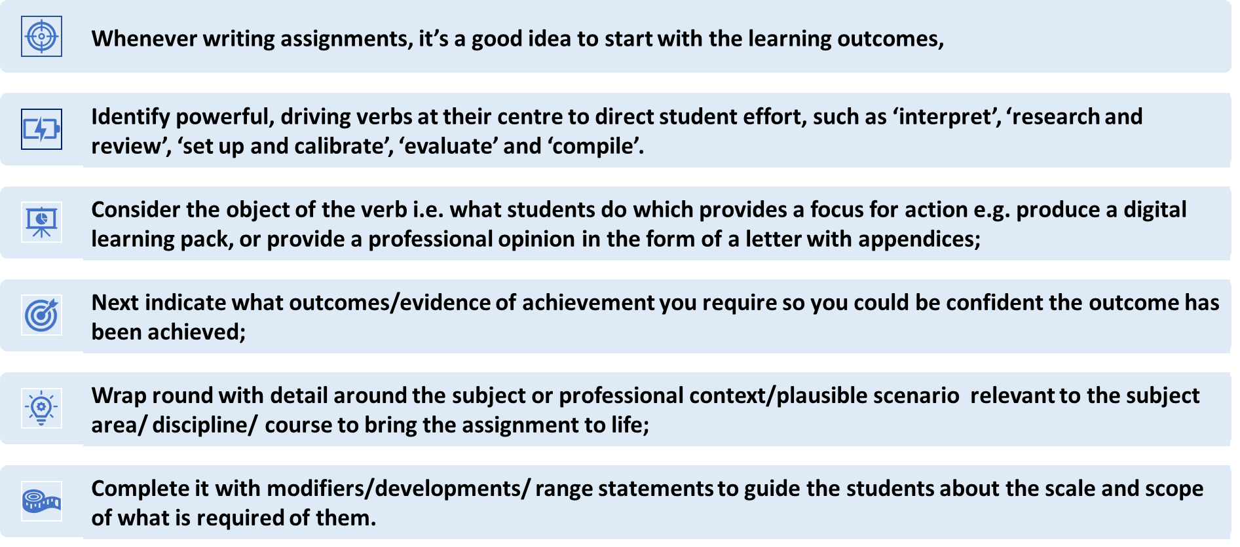
Six steps to designing authentic assignments

Slide 29
Verb/educational outcome | What? i.e. object | Outcome/ evidence of achievement | Modifiers/ developments/ range statements
Interpret | complex and sometimes incomplete or conflicting data | compile a summary meaningful for experts and laypersons | leading to a viable action plan.
Review | data from a variety of sources | produce an executive summary | for a specific audience
Set up | specialised equipment appropriately | draw up a ‘quick guide’ for peers | to enable them to use it safely and appropriately
Evaluate | three proposed solutions to a problem | propose a further two of your own | with suggestions about what might work best
Compile | contingency plans for a professional environment | produce disaster recovery in case of a serious emergency | leading to mitigations and remediation

Slide 30
We will now turn to some illustrative examples: you can see lots more in our compendia…
THE COVID COLLECTION
https://sally-brown.net/kay-sambell-and-sally-brown-covid-19-assessment-collection/
19th March & 3rd May 2021 Compendia of examples of authentic assessment in practice from diverse disciplines
9th June 2021 Mechanics tales: Motivating Mathematics learning through assessment.
13th August, 17th Nov 2021 Two more compendia of examples of authentic assessment in practice

Slide 31

Authentic assessment in Microbiology, based on ideas contributed by Dr Amreen Bashir, School of Biosciences, Aston University
Traditional essay assignment:
What are the key factors leading to poor consumer health in domestic bathrooms caused by contamination? What steps can be taken to improve health though more hygienic practices?

Slide 32

More authentic assessment
Context:
Envisage that you live in a student house with four other students with a downstairs toilet but only one main bathroom that everyone shares upstairs, which also contains a toilet. You are the only microbiologist living in the flat and you are rather concerned at the overall level of hygiene in the flat, particularly the bathroom.

Slide 33
Tasks
Read the two set articles on contamination and highlight/ annotate on a hard copy or on screen what you consider to be the key points. Take a photo or a screen shot of your annotated texts and submit the outcome.
Prepare a poster as a PowerPoint slide for your shared bathroom, highlighting the key contamination risks for your fellow flatmates in language that is likely to be convincing rather than preachy. You may include images, as well as footnotes with information from the articles (this is a student household after all!).
Present your poster to staff/peers in the form of either a live presentation or a 3-minute video recorded on your phone talking through your poster.
Write an article of 700 words for the student newspaper for a wide readership indicating the precautions students living together in shared flats should take in the relation to keeping safe from contamination in the bathroom.
Write 100-word reflection on what undertaking this set of activities has caused you to consider, and identify what actions this has caused you to make your personal behaviour as a result.

Slide 34

Using the task generator to design multi-stage tasks: why?
Linked tasks in a developmental sequence
Gradual incremental build allows time for mastery of challenging concepts/skills and allows early tasks to fulfil a predominantly formative function
Feedback opportunities from low-stakes early tasks feed forward to high-stakes summative tasks

Slide 35
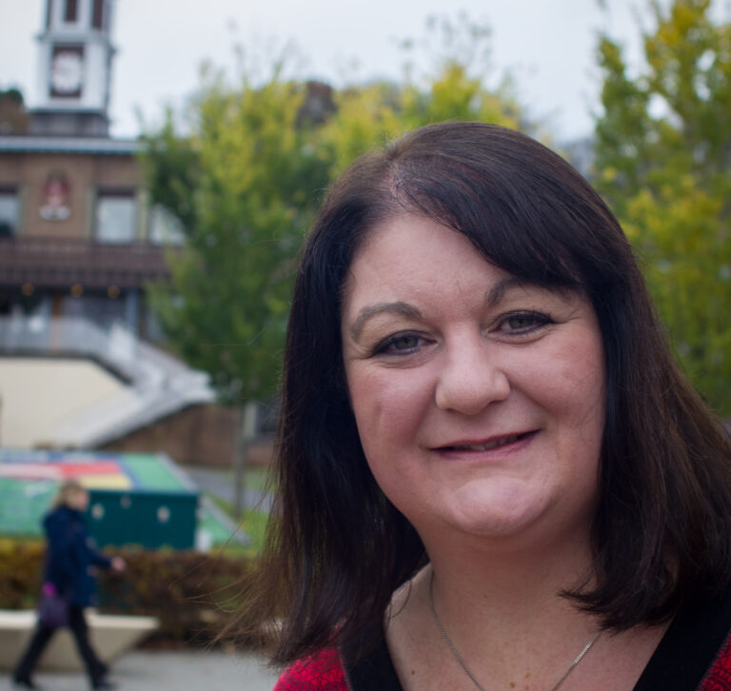
A compendium example from Psychology
Thanks to NTF Prof Julie Hulme, Nottingham Trent University
Traditional exam/essay question:
Discuss the ways in which inter-group conflict can arise and be reduced within a community using social psychological theories

Slide 36
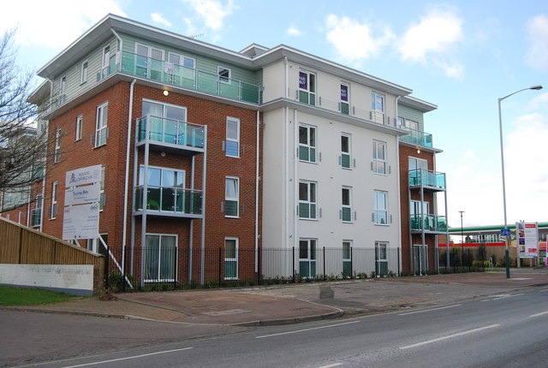
More authentic assessment example
“You are working with a local housing association, and your job is to try to create a sense of community in a small new social housing development in Stoke-on-Trent. The community is home to diverse people, including single people, families, young and old, from lots of different ethnic backgrounds and cultures. In general, everyone has started to settle in well, but you have noticed that there are some tensions arising between the younger residents (mostly care leavers aged 16 to 25) and the older residents (retired people who are mostly over the age of 60). Some younger residents complain that the older residents are nosey, always wanting to know what they're doing, while some older residents complain that the younger residents are always rushing about and can be noisy.”

Slide 37
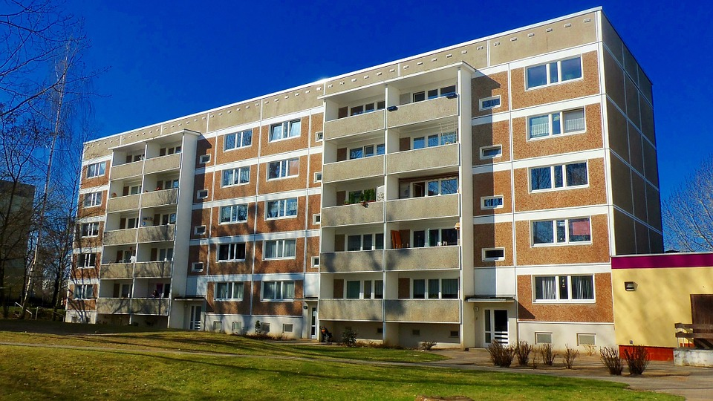
Tasks (as indicated in the Compendium)
Use your understanding of social psychological theories studied in this module to write a short account to explain why this problem might have arisen (500 words).
Propose one way in which you could help to resolve the conflict and help to restore community relations (500 words).
  These two elements should be presented in the form of a report that will be useful for other staff at the housing association.
Provide an annotated reference list, which shows the main sources you used to find the information, and gives a concise summary of the key message from one paper or book chapter that was important to writing your report (full reference list in APA format plus up to 500 words description for your main sources).
Write a short personal reflection (300-500 words) in which you outline what you have learned about resolving intergroup conflict, and how this might influence your current and future practice.

Slide 38
rebalancing formative and summative assessment)
Tasks adapted to illustrate nested multi-stage tasks (rebalancing formative and summative assessment)
Formative
Summative
1. Use your understanding of social psychological theories studied in this module to draft a short account to explain why this problem might have arisen (500 words). Compare this with 2 exemplars provided by the tutor and note any new insights you have developed.
2. In a blog post, propose one way in which you could help to resolve the conflict and help to restore community relations (500 words). Provide constructive comments on one other blog post.
1. Combine the two formative tasks to present a report that will be useful for other staff at the housing association.
2. Provide an annotated reference list, which shows the main sources you used to find the information, and gives a concise summary of the key message from one paper or book chapter that was important to writing your report (full reference list in APA format plus up to 500 words description for your main sources).
3. Write a short personal reflection (300-500 words) in which you outline what you have learned about resolving intergroup conflict, and how this might influence your current and future practice.

Slide 39
Consider using alternative outputs to nudge exams/essays in more authentic direction
Example output
Could be useful for….?
Leaflet or guidance document
Reflective commentary
Grant application/bid for funding
Analysis of live data
Writing concisely for a specific audience/ simplifying complex information for laypersons
Consider process as well as outputs & develop self review
Ability to make convincing case against criteria
Make calculations reliably and accurately
Notes:
Here’s where the idea of a continuum comes in again- not all assts have to be like Ben Chan’s- can break into mini-tasks (with outputs which large teaching teams can distribute, or which can be formative, and which can be used to nudge an exam/essay in a somewhat more auth/relevant direction )
This extract from our recent table (in January 9th blogpost) of alternatives represents outputs you could ask for in essays/exams as the other end of spectrum from ‘requires major design featuresSEE HANDOUT TO TAKE AWAY

Slide 40
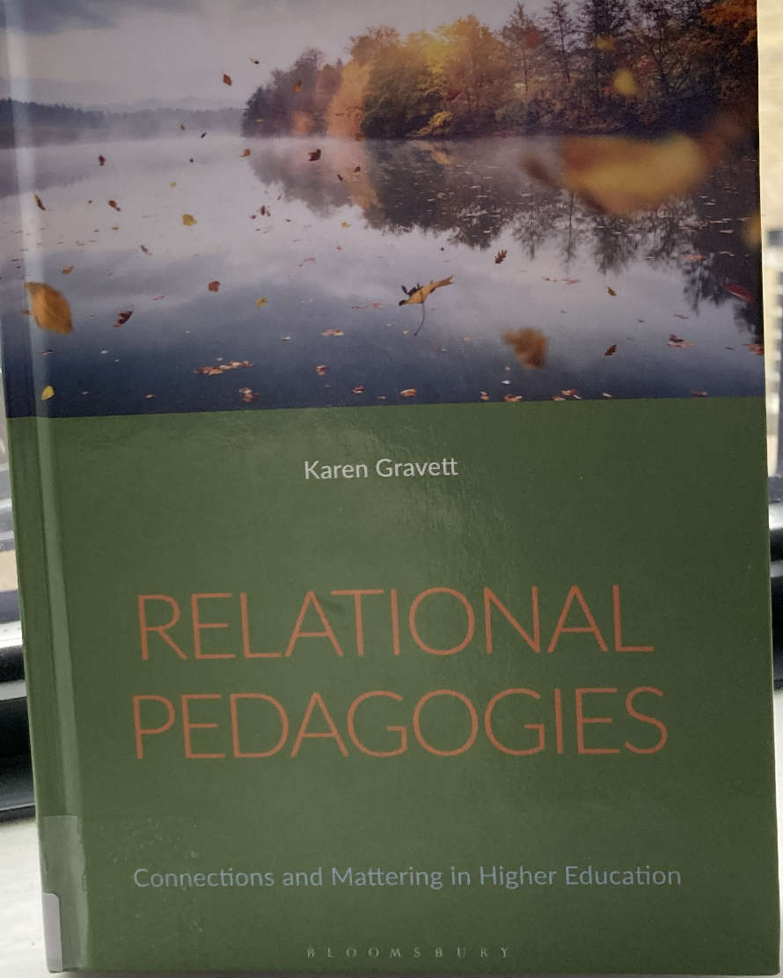
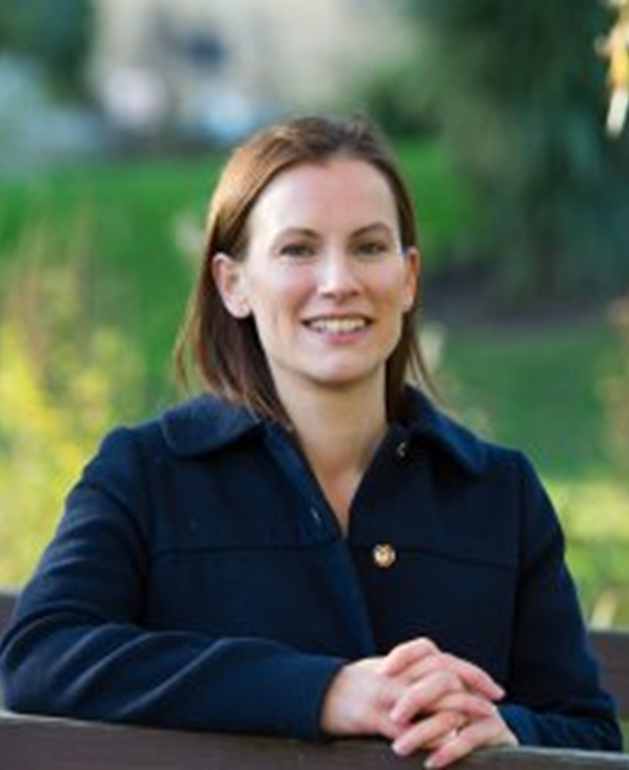
AfL links to new work on relational pedagogies (Gravett, 2023) which focuses attention on how students flourish, thrive and collaborate as partners in shared educational endeavour
Prompts us to pay attention and think critically about how to engage, care and connect with students- that is, how to instil in them a sense that they matter
Not in a ‘therapeutic’ way, but in the quality of their connections and relationships to
  people -to self, and others (peers, us, staff)
  their subject -so they see and feel how ideas and knowledge in their field/subject matter
  to material/non-human things, e.g. technology; spaces.
While Relational Pedagogies takes a very broad sweep, Gravett and Fairchild (2021) importantly recognise that assessment is a key dimension in pedagogies of mattering, asserting that we can enact assessment differently to
  diminish the notion that assessment is something done to students, but something they do and have a stake in- so that it’s viewed as a ‘lively affair’ that’s not just cognitive, but folds in to things that matter to them
  is a process they participate in not just a product they hand in;
  pays better attention to their situated particularities and developing subjectivities as learners,
  and is folded into learning and teaching not an adjunct

Slide 41
In conclusion
The time is ripe to rethink how we make assessments happen and how we actively involve and engage students over time by
  looking carefully at the balance between formative activity in feedback-rich environments
  using high-stakes summative assessment rigorously but sparingly
  involving students in tasks- not all for marks- that they see as productive, forward-looking and authentic (relevant)
It means we interrogate the value or worth of our assessments
  for employability
  for society/citizenship & social justice
  and for students’ identities and individual aspirations.

Slide 42


Thank you
Contact us
s.brown@leedsbeckett.ac.uk @ProfSallyBrown
Kay.sambell@cumbria.ac.uk @kay_sambell
Hope to see some of you next week:
Thursday 20 & Friday 21 June 2024 in Manchester UK
for the next Assessment in Higher Education Conference
Details and CFP:
https://ahenetwork.org

Slide 43
Useful guides and practical resources
Arnold, L. (2022) Expanded Assessment Top Trumps – Lydia Arnold (lydia-arnold.com)
Brown, S. & Sambell, K. Working Towards More authentic assessment posted 9/01/2023 Authentic-assess-blogpost-f1.docx (766 downloads) (sally-brown.net)
Brown, S., & Sambell, K. 2020 https://sally-brown.net/kay-sambell-and-sally-brown-covid-19-assessment-collection/
(including the Task Generator blueprint in ‘Writing Better Assignments in Post-Covid era’ 17/08/2020, and various compendia of illustrative examples)
Brown, S., Sambell, K and Farrell, A 2022 Assess for Success Guides at Assess for Success | Maynooth University
Dawson, P. 2023 WWG_Addressing-cheating-by-balancing-academic-integrity-and-assessment-security.pdf (hw.ac.uk)
Drumm, L. 2023 15 Artificial Intelligence, Student Learning and Assessment Quick Guide.pdf (napier.ac.uk)
Francis, N and Smith, D. 2023 Generative AI and Assessment Generative AI in assessment (edgehill.ac.uk)
Hartley et al n.d. Programme Assessment Strategies (PASS) - University of Bradford
JISC 2023 Assessment ideas for an AI enabled world Available with a range of other resources at National centre for AI - Jisc (scroll to bottom of page for the postcards, which aim to provoke discussion and reflection about assessment approaches in HE) https://repository.jisc.ac.uk/9234/1/assessment-ideas-for-an-ai-enabled-world.pptx
Logan Fleming, Sotiriadou, Daly, & Guest n.d. Interactive Oral Assessment; an authentic and integral alternative to examination. (office.com)
Sambell & Brown 2023 Choosing-and-using-fit-for-purpose-assessment-methods https://sally-brown.net/download/3496/ Heriot Watt University LT Academy Assessment and Feedback - Learning and Teaching Academy (hw.ac.uk)
Tai, J., Ajjawi, R., Bearman, M., Dargusch, J., Dracup, M., Harris, L., and Mahoney, P. (2021). Five ways to develop inclusive assessment in higher education Centre for Research in Assessment and Digital Learning, Deakin University. doi:10.6084/m9.figshare.16543794
UCL Arena Guides Engaging with AI in your education and assessment | Students - UCL – University College London

Slide 44
References and useful reading (1)
Ajjawi, R., Tai, J., Huu Nghia, T. L., Boud, D., Johnson, L., & Patrick, C.-J. (2019). Aligning assessment with the needs of work-integrated learning: The challenges of authentic assessment in a complex context. Assessment & Evaluation in Higher Education, 45(2), 304–316.
Ashford-Rowe, K., Herrington, J. and Brown, C. (2014) ‘Establishing the critical elements that determine authentic assessment’, Assessment and Evaluation in Higher Education, 39(2), pp. 205–222. doi: 10.1080/02602938.2013.819566
Bender, E.M., Gebru, T., McMillan-Major, A. and Shmitchell, S., 2021, March. On the dangers of stochastic parrots: Can language models be too big?. In Proceedings of the 2021 ACM conference on fairness, accountability, and transparency (pp. 610-623).
Biggs, J. (1996). Enhancing teaching through constructive alignment. Higher Education, 32, 347–364
Boud, D. and Molloy, E., 2013. Rethinking models of feedback for learning: the challenge of design. Assessment & Evaluation in higher education, 38(6), pp.698-712.
Brown, S. and Race, P. chapter 6 Using effective assessment and feedback to promote learning in Hunt, L. and Chambers, D. (2020) University Teaching in Focus, Victoria, Australia: Acer Press, p.74-91.
Bryant, P (2023) Navigating the dissonances of authenticity in assessment: (Re)defining authentic assessment in business education (part 3) - Disruptive Innovations in Business Education Research Group (diberg.blog)
Davison, G.,2011. Investigating the Relationships Between Authentic Assessment and the Development of Learner Autonomy. Doctoral thesis, Northumbria University
Dawson, P., Nicola-Richmond, K. and Partridge, H., 2023. Beyond open book versus closed book: a taxonomy of restrictions in online examinations. Assessment & Evaluation in Higher Education, pp.1-13
French, S., Dickerson, A. and Mulder, R.A., 2023. A review of the benefits and drawbacks of high-stakes final examinations in higher education. Higher Education, pp.1-26.
Gravett, K., Taylor, C.A. and Fairchild, N., 2021. Pedagogies of mattering: re-conceptualising relational pedagogies in higher education. Teaching in Higher Education, pp.1-16.
Gravett, K., 2022. Relational Pedagogies: Connections and Mattering in Higher Education. Bloomsbury Publishing.

Slide 45
References (2)
Gulikers, J. T. M., Bastiaens, T. J., & Kirschner, P. A. (2004). A five-dimensional framework for authentic assessment. Educational Technology Research and Development, 52(3), 67–86. http://www.jstor.org. ezproxy.lancs.ac.uk/stable/30220391
Gulikers, J.T., Bastiaens, T.J., Kirschner, P.A. and Kester, L., 2008. Authenticity is in the eye of the beholder: student and teacher perceptions of assessment authenticity. Journal of Vocational Education and Training, 60(4), pp.401-412.
Hobbins, J., Kerrigan, B., Farjam, N., Fisher, A., Houston, E. and Ritchie, K., 2021. Does a classroom-based curriculum offer authentic assessments? A strategy to uncover their prevalence and incorporate opportunities for authenticity. Assessment & Evaluation in Higher Education, pp.1-15.
Jessop, T., 2023. Student Agency and Engagement: Transforming Assessment and Feedback in Higher Education. Taylor & Francis.​
Kramm, N. and McKenna, S., 2023. AI amplifies the tough question: What is higher education really for?. Teaching in Higher Education, pp.1-6.
Lodge, J. M., Howard, S., Bearman, M., Dawson, P, & Associates (2023). Assessment reform for the age of Artificial Intelligence. Tertiary Education Quality and Standards Agency
McArthur, J., 2022. Rethinking authentic assessment: work, well-being, and society. Higher Education, pp.1-17.
National Forum for the Enhancement of Teaching and Learning (2017) Authentic Assessment in Irish Higher Education in teachingandlearning.ie
Nieminen, J.H., 2022. Assessment for Inclusion: rethinking inclusive assessment in higher education. Teaching in Higher Education, pp.1-19.
Nieminen, J.H. and Ketonen, L., 2023. Epistemic agency: a link between assessment, knowledge and society. Higher Education, pp.1-18
Sambell, K., Brown, S. and Race, P., 2019. Assessment as a locus for engagement: priorities and practicalities. Italian Journal of Educational Research, pp.45-62.
Sambell, K, McDowell, L and Montgomery, C. (2013) Assessment for Learning in Higher Education. Routledge.

Slide 46
References (3)
Sambell, K., McDowell, L. and Brown, S., 1997. “But is it fair?”: an exploratory study of student perceptions of the consequential validity of assessment. Studies in educational evaluation, 23(4), pp.349-371.
Sokhanvar, Z., Salehi, K. and Sokhanvar, F., 2021. Advantages of authentic assessment for improving the learning experience and employability skills of higher education students: A systematic literature review. Studies in Educational Evaluation, 70, p.101030.
Sotiriadou, P., Logan, D., Daly, A. and Guest, R., 2019. The role of authentic assessment to preserve academic integrity and promote skill development and employability. Studies in Higher Education, pp.1-17.
Tai, J., Ajjawi, R., Boud, D., Dawson, P. and Panadero, E., 2018. Developing evaluative judgement: enabling students to make decisions about the quality of work. Higher Education, 76(3), pp.467-481.
Villarroel, V., Bloxham, S., Bruna, D., Bruna, C. and Herrera-Seda, C., 2018. Authentic assessment: Creating a blueprint for course design. Assessment & Evaluation in Higher Education, 43(5), pp.840-854.
Villaroel, V., Boud, D., Bloxham, S., Bruna, D. and Bruna, C., 2020. Using principles of authentic assessment to redesign written examinations and tests. Innovations in Education and Teaching International, 57(1), pp.38-49.
Ward, M., O’Riordan, F., Logan-Fleming, D., Cooke, D., Concannon-Gibney, T., Efthymiou, M. and Watkins, N., 2023. Interactive oral assessment case studies: An innovative, academically rigorous, authentic assessment approach. Innovations in Education and Teaching International, pp.1-18.
Wiggins, G. (1990). The case for authentic assessment. Practical Assessment, Research, and Evaluation, 2, 1–3
Wiliam, D 2022 The role of assessment in promoting social justice, 3RD Virtual meeting on Higher Education, University del Desarrollo, Chile, 15th November 2022.
Winstone, N. and Carless, D., 2019. Designing effective feedback processes in higher education: A learning-focused approach. Routledge.

Slide 47


Assessment in an AI-enabled world
Everyone's talking about Generative AI.

Slide 48


Approaches to AI /LLMs
Ban/ revert?
Outsmart / detect?
Embrace / enable?
Notes:
Everyone’s talking and worrying about AI these days- and we’re all learning. It seems impossible to evade or ban it; and a fool’s errand to try and outsmart/detect it as it gets more powerful; so we’re learning to embrace and enable ethical use and consider if and how we might we foster positive behaviours and integrating it more in developmental tasks? But also noting the importance of balancing asst security with these AfL approaches. (cf EEllis, C. and Murdoch, K., 2024. The educational integrity enforcement pyramid: a new framework for challenging and responding to student cheating. Assessment & Evaluation in Higher Education, pp.1-11.
Its def provoking (some useful) conversations: For instance, the ubiquity of chat gpt is calling into q the focus on judging by written outputs alone, and its impt stakeholders realise its limitations- nb stochastic parrot metaphor as outlined by bender.. . As Chatty G explains itself -’contrary to how it may seem when we observe its output, an LM is a system for haphazardly stitching together sequences of linguistic forms it has observed in its vast training data, according to probabilistic information about how they combine, but without any reference to meaning: a stochastic parrot. Do not truly understand the language they process and, like parrots, mimic human language by predicting sequences of words based on probability, much like a parrot mimics sounds with no comprehension of their meaning. The term ‘stochastic parrot highlights the potential limitations and risks of relying on statistical patterns without genuine comprehension.
Bender, E.M., Gebru, T., McMillan-Major, A. and Shmitchell, S., 2021, March. On the dangers of stochastic parrots: Can language models be too big?. In Proceedings of the 2021 ACM conference on fairness, accountability, and transparency (pp. 610-623).

Slide 49
Can we help students use AI tools productively and ethically to support their learning? (Drumm, 2023)
Address cheating by carefully balancing assessment security and academic integrity (Dawson, 2023)
E.g. as low stakes conversational partner, ideas generator, suggest structures, enhance communication of own ideas
Help ensure students see they need to
look at AI outputs with a critical eye
see the need to use AI content to help their learning, not do their learning
realise they must always correct, refine and improve AI content (not copy and paste it), documenting usage, prompts, changes.
Reserve assessment security (i.e. determine if students have done work in the conditions prescribed) for mission critical elements of the programme
Use other AfL elements to promote learning and focus on building academic integrity
  honesty, trust, fairness, respect and responsibility
Notes:
Can we can help students recognise that, as Louise Drumm suggests, while AI might be useful as a conversational partner, or to generate ideas to get them started, or think of structures, or suggest how to better communicate their ideas, students need
to look at AI outputs with a critical eye
to see the need to use AI content to help their learning, not do their learning
to realise they must always correct, refine and improve AI content not copy and paste it, documenting changes.
Consider Phill Dawson’s suggestion that we carefully balance adversarial assessment security and academic intergriety for mission critical elements of the programme (ie where we absolutely need to determine if students have done work in the conditions prescribed and where we need to authenticate that the person is who they say they are) rather than other ones, where the main purpose is learning, where we can focus on academic integrity as “a commitment to five fundamental values: honesty, trust, fairness, respect and responsibility” (Fishman, 2014). Alth auth asst is not a pancea for cheating, a mvt towards authenticity in asst can be v helpful in promoting positive academic integrity which seeks to develop students so they can do (and want to do) work ethically,- and again there are lots of resources and alternatives to help us.[See JISC}

Slide 50
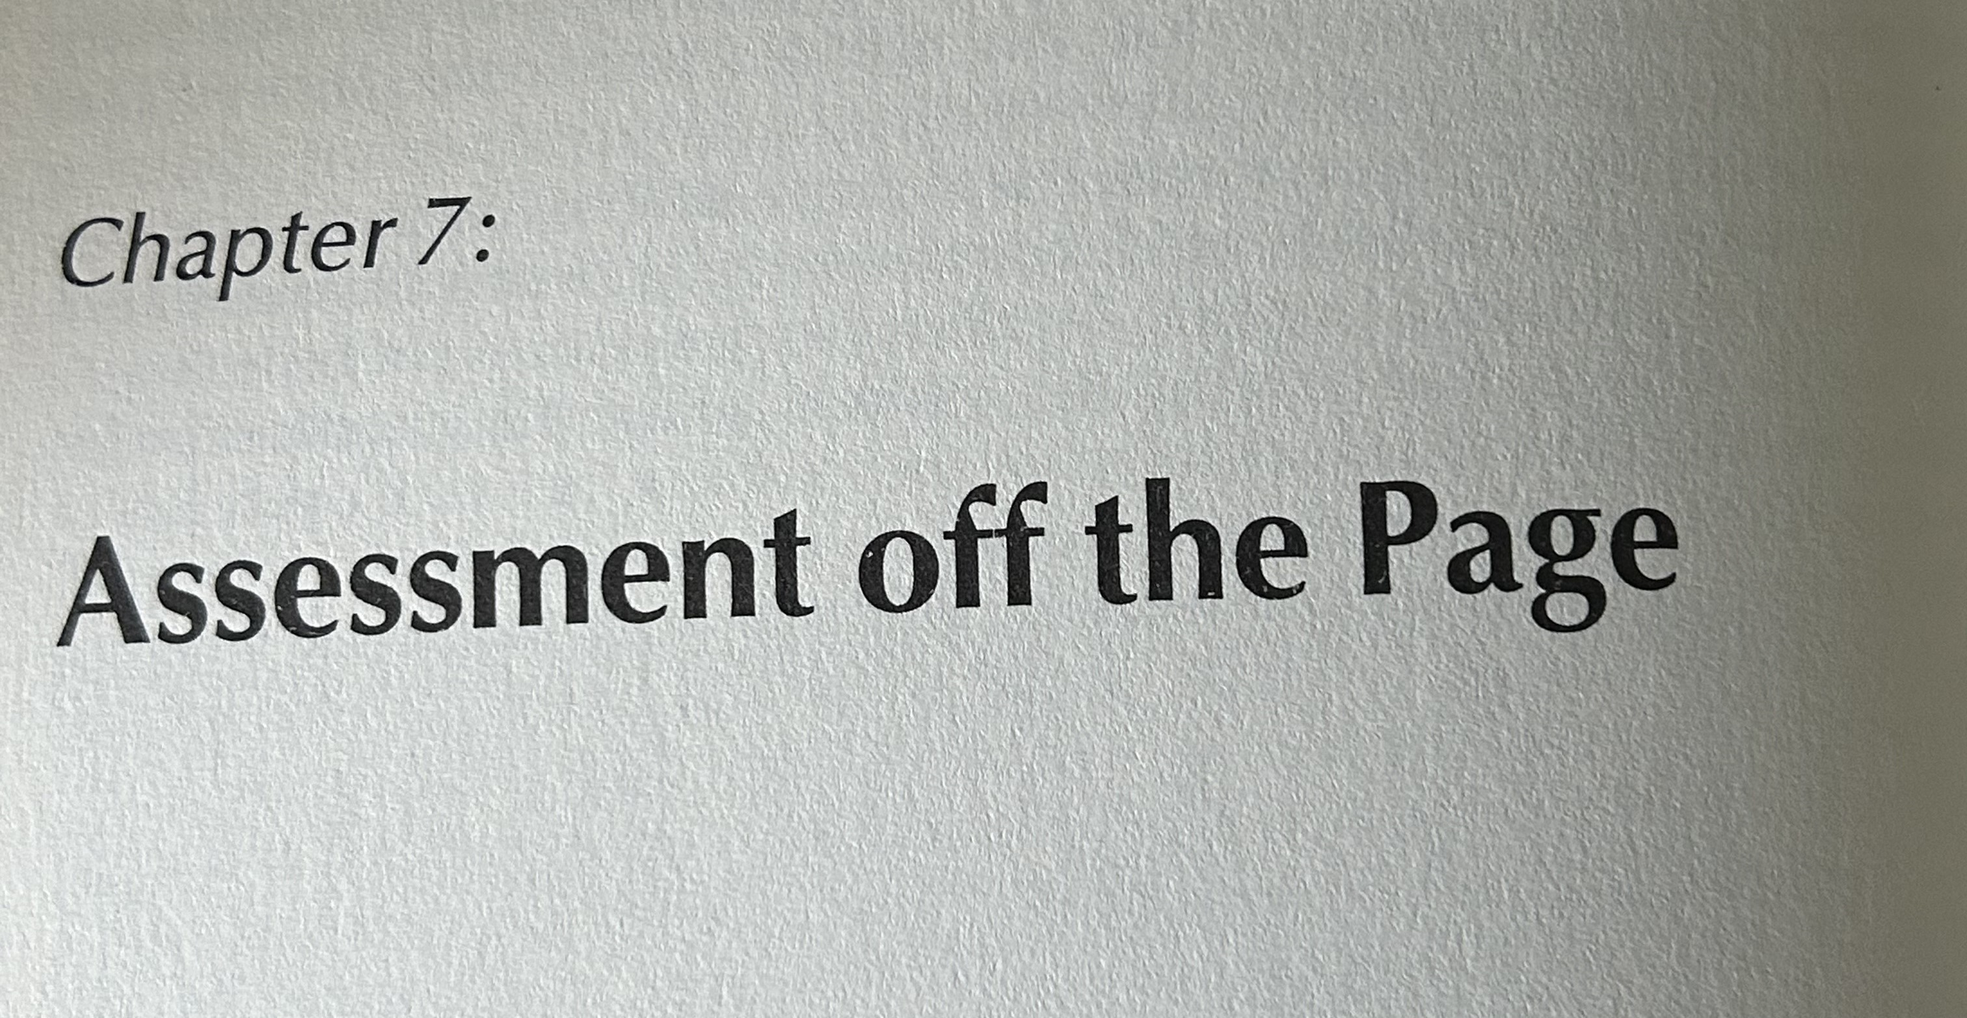
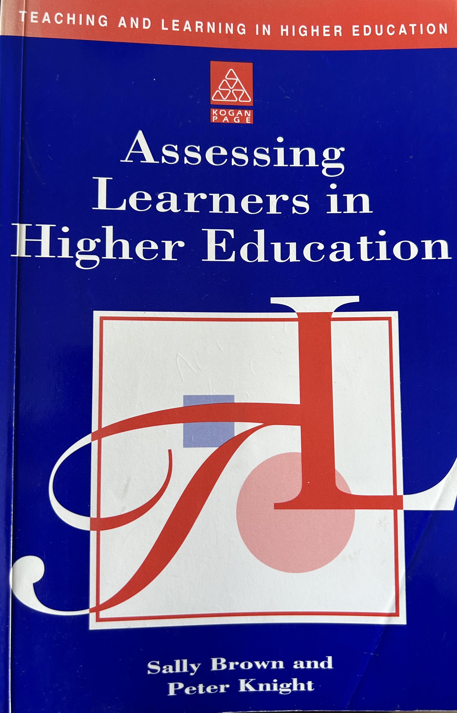
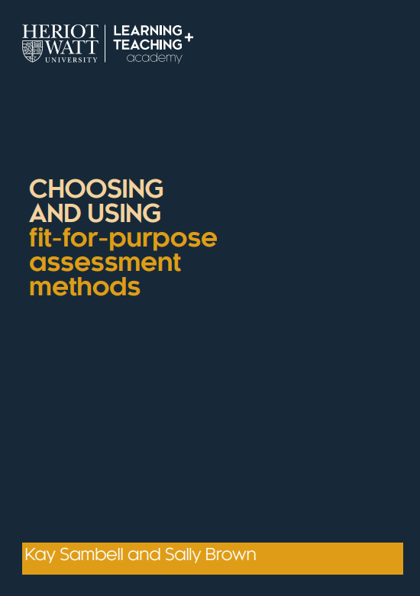
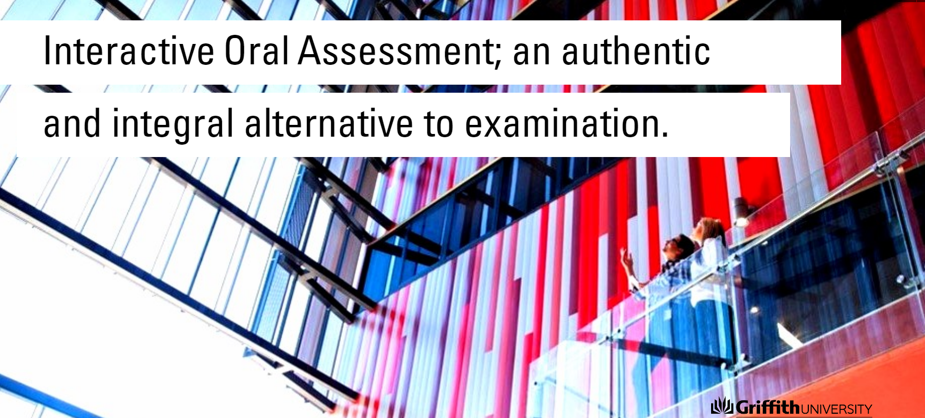

Consider alternatives to text-based assessment methods?
1. Bring assessment ‘off the page’, (Brown & Knight, 1994) using diverse methods e.g. posters, design & build, podcasts…
2. Use more interactive, oral assessment (IOA) methods (Sotiriadou et al, 2019)
See framework for using IOA at scale at Griffiths University
Interactive Oral Assessment; an authentic and integral alternative to examination. (office.com) a resource developed by Logan Fleming et al 2020
And case studies from Dublin City University (Ward, M., et al, 2023)

Slide 51

Interactive oral assessments (Sotiriadou et al, 2019)
Real-life scenario ( or time release case study) to guide a genuinely two-way, free-flowing, unscripted conversation, that’s been designed to verbally assess students
requires learners to synthesise and apply the skills and learning they have developed
demonstrate agility & apply their learning in a conversational and fluid manner in a two- way interactive conversation.
authentic and linked to employability and lifewide situations
shown to work effectively in a range of disciplines and, most importantly, at scale, with hundreds of students (not just small cohorts)

