Slide 1
Living Professionalism joysmounter@gmail.com
welcome
Notes:
Hello – Name – Can’t be with you – researching my practice over 25 years as a teacher/ Head/ uni lecturer/ MA Course Leader

Slide 2
Future Possibilities ~ Please Get in Touch
Values-led practice
Living professionalism.
Inspire
Question, engage.
Please contact us
Future possibilities
Notes:
My focus - values-led leadership within Living Professionalism the focus of my doctoral research.

Slide 3
Notes:
Just wanted ot touch briefly on my experiences of CPD in the various settings I worked within.
Mostly skills/ knowledge-based – around a national focus linked to English and Maths targets.
Didn’t always gel with the focus I wanted for my pupils/ students
Didn’t excite me, generate interesting conversations, network with others
Didn’t keep me engaged and committed to profession.
SLIDE-expand – LETR - key

Slide 4
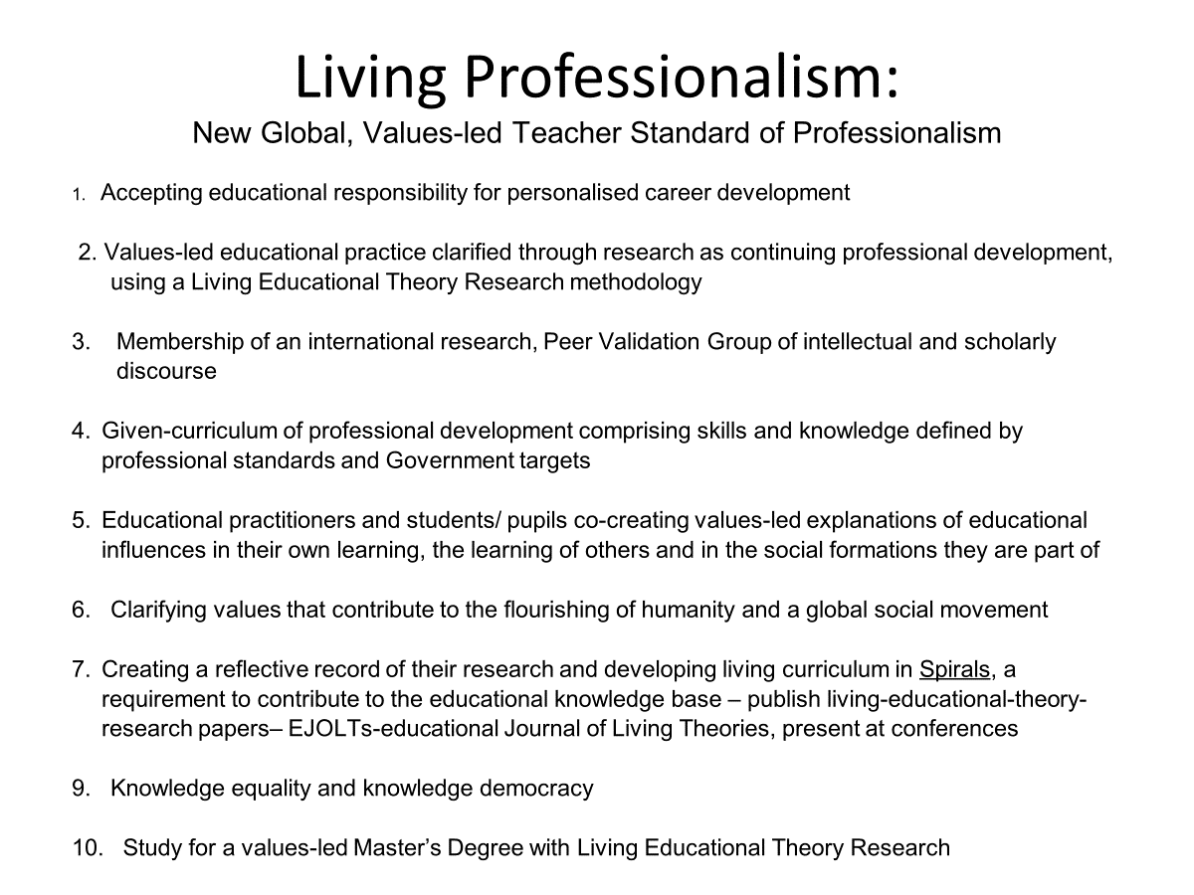
Notes:
My doctoral research is the culmination of a 25 year journey as a Living Educatioanl Theory Researcher aligning my professional values with my practice. Living Professionalism has been created as a CPD focus for values-led practitioners internationally. It compliments any countries teacher standards of key knowledge, skills and competencies, offering reflective research into applying developing knowledge skills and competencies in a values-led framework of practice.
10 aspects to Living Professionalism.

Slide 5
Living Professionalism- Masters MA: Values-led Leadership
Living Professionalism clarifies and communicates a new global, living standard of judgement of teacher professionalism:
Research led continual professional development – utilising Living Educational Theory Research & a practitioner’s values
Design and accreditation of unique MA: Values-led Leadership for the continuing professional development of teachers with a global perspective on professional learning that is focused on the learning of master and doctor educators.
Research is grounded in the acceptance of educational responsibility, exploring the implications of asking, researching and answering questions of the kind, ‘How do I improve my professional practice with values of human flourishing?’.

Slide 6
Living Educational Theory Research
Professional practitioners ask, research and answer questions of the kind, ‘How do I improve my professional practice with values of human flourishing?’
Professional practitioners identify where they experience:
themselves as a living-contradiction in their practice and/or
where they experience their values contradicted by others and/or
Experience their values contradicted by the social formation which forms the context of their professional practice
Their research is informed by what they do to resolve the tensions of experiencing themselves as a living-contradiction and/or or their values contradicted by others or context

Slide 7
Living Educational Theory Research
In the process of their research they clarify their embodied meaning of their professional practitioner values of human flourishing
They draw on their values to explain why they do what they do and as their standards of judgement in improvement in their practice
They test the validity of their knowledge claims by submitting them to a peer validation group and publishing in peer reviewed journals
The validated account of their research contributes to the growth of a global educational knowledge-base all may benefit from

Slide 8
What difference did engaging in Living Educational Theory Research make to my practice as a class teacher, Deputy, Headteacher, and finally lecturer?
* values-led practitioner
* Inspired commitment to my own CPD
* local, national, inter-national professional relationships
* Empowered my pupils/ students
*Rippling effect of positive energy
* Clarity in my professional Practice
* Desire to make a difference – community, professional knowledge-base, future possibilities

Slide 9
What difference did it make to the quality of the educational experiences, opportunities and relationships I created for my pupils and students as I researched my practice to understand and improve it and generate valid accounts of my living-educational-theories?
*Co-researchers creating a holistic perspective of practice in my classroom
*Pupils researching their own learning, values, as a person
*Pupils created their own learning theory after researching theories of the day – Guy Claxon, Belle Wallace etc.
*Pupils that challenged my thinking – “How can you write about learning without us?”
*Understanding of learning in different ways, strengths, areas to develop, academic interests
* M.A.D.+ - Make a Positive Difference
* Personal living-archive called Spirals

Slide 10
Why did I keep researching my practice over 25 years in my different roles?
Simple, because of the energising, exciting, positive difference it made to my life, both personally and professionally, as well as to my pupils/ students
Sense of belonging within a values-led community of researchers
Making a small difference in the world – values-led, professional knowledge-base
Making a difference in the engagement of my pupils, students in their own learning and understanding of self in the world and the difference they can make

Slide 11
Living Professionalism: a New Professional, Values-led Teacher Standard of Professionalism
“… where educational practitioners accept educational responsibility for their own continuing, values-led, professional development. This includes teachers continually researching their practice to improve it, generating values-laden explanations of their educational influence in learning, contributing to the growth of a global educational knowledgebase.”
(Mounter, J. (2024) A Living Educational Theory Research Approach to Continuing Professional Development in Education. PhD thesis, Abstract) joysmounter@gmail.com

